Slide 1



DevOps in the Cloud for the .NET Developer
Scott Addie | Senior Content Developer | @Scott_Addie

Slide 2
Agenda
Overview of DevOps
Right-click > Publish
Azure DevOps Services
Docker
GitHub
Demo

Slide 3

What is DevOps?
Developers, Operations, QA
People
Products
Process
…the union of people, process, and products to enable continuous delivery of value to our end users. – Donovan Brown, Microsoft
Continuous Build & Delivery
DevOps
Azure DevOps Services
Notes:
People following a process enabled by products to deliver value to end users

Slide 4



The DevOps pipeline
Git repo
Build tasks
Release tasks

Slide 5

The fallacy of right-click > Publish
Doesn’t scale beyond 1 person
Local dependencies may differ from prod
Steps are forgotten

Slide 6
Azure DevOps Services

Slide 7

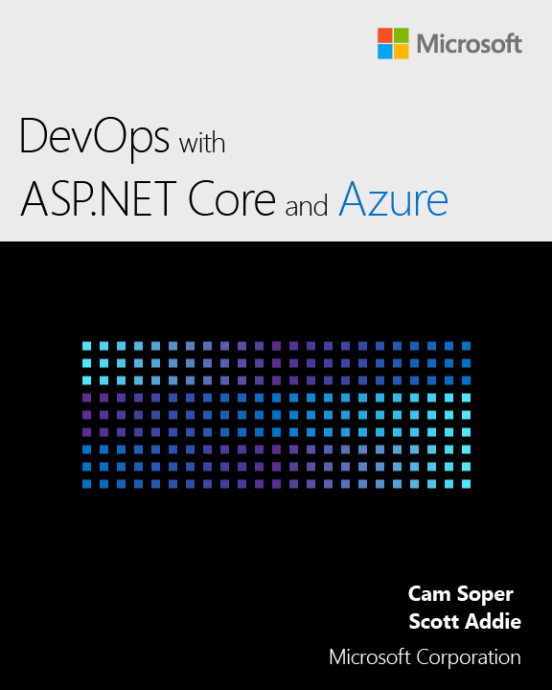
Resources
eBook @Scott_Addie
aka.ms/aspnetdevops
Slides
aka.ms/aspnet-devops-slides
Code
aka.ms/app-secrets-code

